Slide 1

COVID-19 Update
(Coronavirus Disease 2019)
DuPage County School Superintendent Meeting
Karen Ayala, MPH – Executive Director
kayala@dupagehealth.org
Rashmi Chugh, MD, MPH – Medical Officer
rchugh@dupagehealth.org
March 2, 2020
Notes:
Updated: 2/02/2020

Slide 2

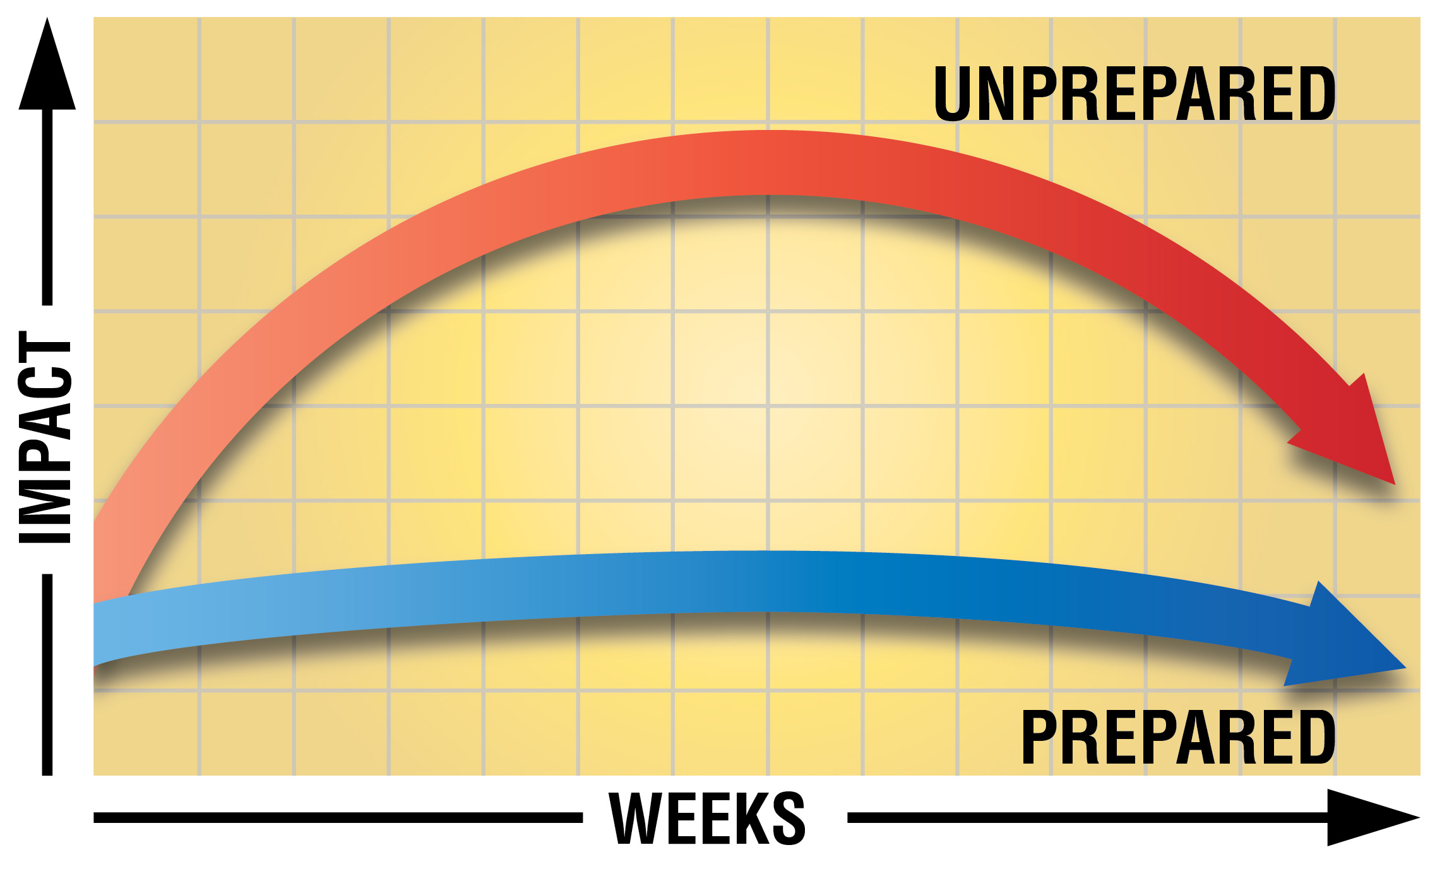
Be Ready. Be Prepared.
During an outbreak, the more educated and prepared the public, the lower the health, social and economic impact.

Slide 3
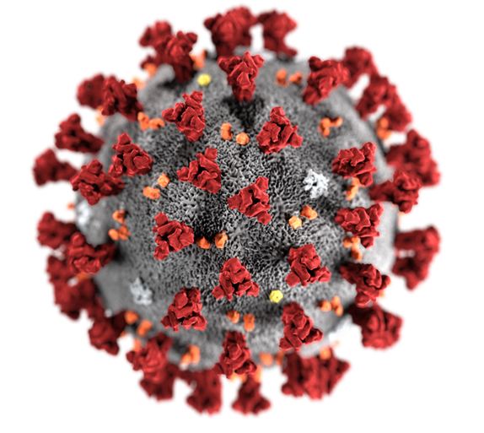
COVID-19: Update
What is COVID-19?
Common human coronaviruses usually cause mild to moderate upper-respiratory tract illnesses, like the common cold.
Most people get infected with one or more of these viruses at some point in their lives and these should not be confused with COVID-19
COVID-19 is a new respiratory illness in people and can spread from person-to-person.
The virus has been named “SARS-CoV-2” and the disease it causes has been named “coronavirus disease 2019” (abbreviated “COVID-19”).
This virus was first identified during an investigation into an outbreak in Wuhan, China in December 2019.

Slide 4
COVID-19: How It Spreads
Investigations are ongoing to better understand routes of transmission
Largely based on what is known from other coronaviruses
  Presumed to occur primarily through close person-to-person contact
    May occur when respiratory droplets are produced when an infected person coughs or sneezes
  Possibly by touching a surface or object that has the virus on it and then touching the mouth, nose, or eyes
Symptoms may include
  Fever
  Cough
  Shortness of breath
Wide range of illness severity reported
Mild to severe illness
Can result in death
  Estimated incubation period
  2 to 14 days
  Complications may include
  Pneumonia
  Respiratory failure
  Multisystem organ failure

Slide 5


Preventive Steps for Travelers
COVID-19
Update
Based on assessment of your recent travel history and symptoms, additional steps are being taken to prevent potential spread of COVID-19. You should remain at home for 14 days. Your local health department will monitor you by email or by phone 2 times a day for 14 days. You should check and record your temperature and any symptoms every day, twice per day for 14 days. You should follow the prevention steps until your local health department says you can return to your
normal activities.
Risk Assessment and Monitoring
Accessed 2/10/20
https://www.cdc.gov/coronavirus/2019-ncov/travelers/communication-resources.html

Slide 6
IMPORTANT TERMS
Close Contact
An individual who has been within 6 feet (2 meters) of a COVID-19 case for a prolonged period of time; close contact can occur while caring for, living with, visiting, or sharing a health care waiting area or room with a COVID-19 case
- OR -
An individual who has had direct contact with infectious secretions of a COVID-19 case (e.g., being coughed on). Considerations when assessing close contact include the duration of exposure and the clinical symptoms of the person with COVID-19.
COVID-19 Update
Person Under Investigation (PUI)
Isolation
An individual with clinical features and epidemiologic risk.
To separate and restrict the movement of ill persons with contagious disease from people who are not sick to prevent further spread.
Confirmed Case
Quarantine
An individual with COVID-19 clinically-compatible illness, exposure history, and lab confirmation.
To separate and restrict the movement of people who were exposed to a contagious disease to prevent spread of disease.
As of 2/27/2020 www.cdc.gov/coronavirus/2019-nCoV/hcp/clinical-criteria.html
As of 2/11/2020 www.cdc.gov/coronavirus/2019-ncov/php/risk-assessment.html

Slide 7
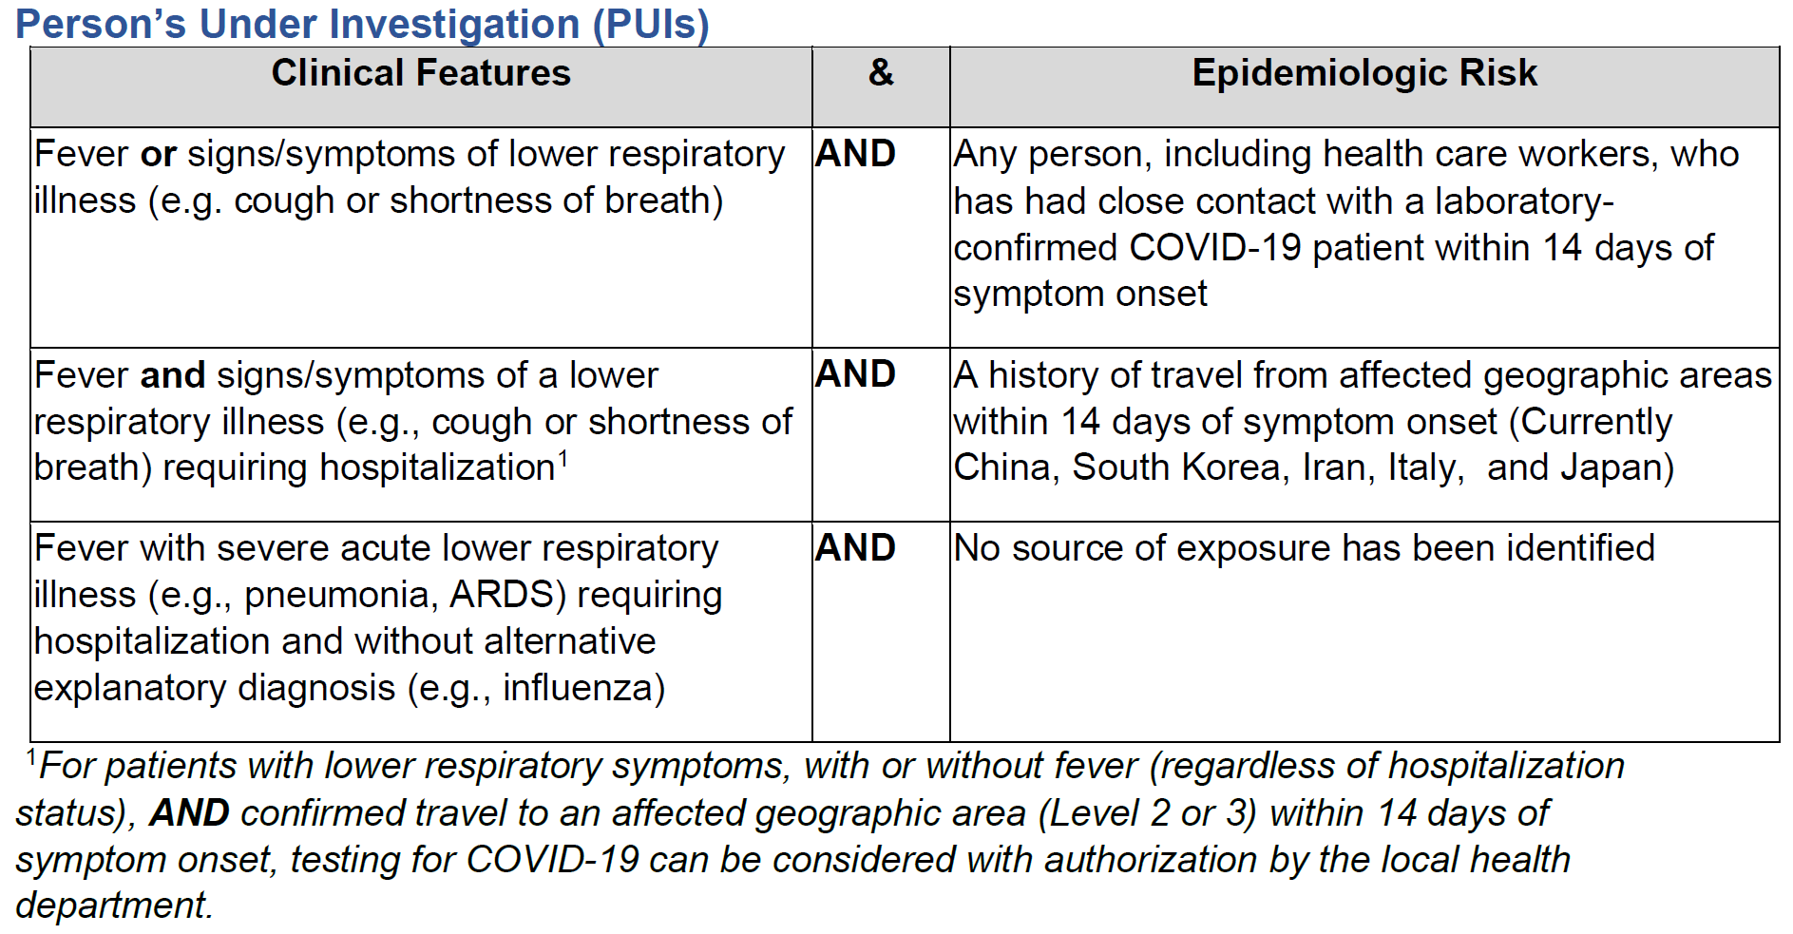
COVID-19:
Criteria to Guide Evaluation of PUI
Affected Geographic Areas with Widespread or Sustained Community Transmission
Last updated February 26, 2020
China
Iran
Italy
Japan
South Korea
See all COVID-19 Travel Health Notices.
Source: IDPH Health Alert Dated 2/28/20
Notes:
Updated: 2/3/2020
Notes:
1 Fever may be subjective or confirmed. Fever may not be present in some patients, such as those who are very young, elderly, immunosuppressed, or taking fever-reducing medications. Clinical judgement should be used to guide testing of patients in these situations.
2 Close contact is defined by being within 6 feet (12 meters) or within the room or care area of a 2019-nCoV case for a prolonged period of time while not wearing recommended PPE (e.g., gowns, gloves, NIOSH-certified disposable N95 respirator, eye protection). Close contact can include caring for, living with, visiting, or sharing a healthcare waiting area or room with a 2019-nCoV case OR by having direct contact with infectious secretions of a 2019-nCoV case (e.g. being coughed on) while not wearing PPE. Consider duration of contact and clinical symptoms of ill patient to inform “close contact.”
3 Documentation of laboratory confirmation of 2019-nCoV may not be possible for travelers or persons caring for patients in other countries
4 Category also includes any member of a cluster of patients with severe acute lower respiratory illness (e.g. pneumonia, ARDS) of unknown etiology in which 2019-nCoV is being considered that requires hospitalization. Such persons should be evaluated in consultation with state and local health departments regardless of travel history
If there is uncertainty, patients should be evaluated and discussed with local health departments on a case-by-case basis. The exposure locations under Epidemiologic Risk will continue to evolve and are subject to change.

Slide 8
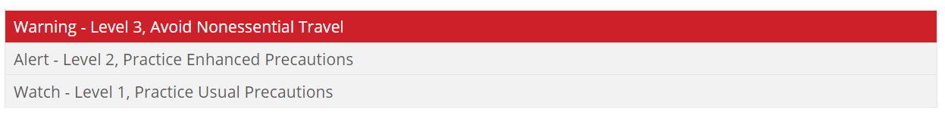
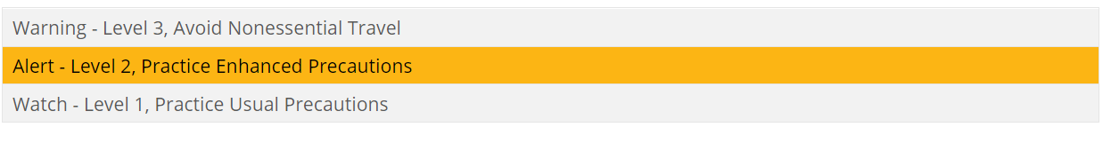
CDC Travel Notices (as of 3/2/20)
COVID-19
Update
Italy, China, South Korea and Iran
Centers for Disease Control and Prevention
Travel Health
Alert Notices
(updated frequently)
Japan
Accessed 3/2/20
https://www.cdc.gov/coronavirus/2019-ncov/travelers/index.html

Slide 9
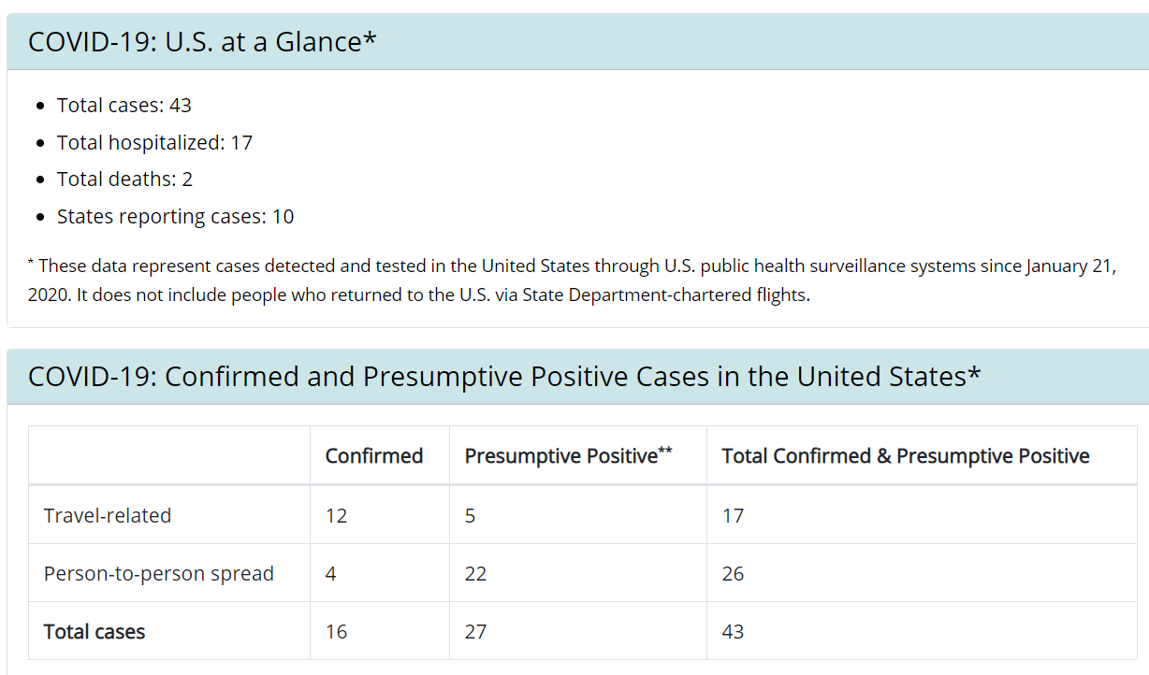
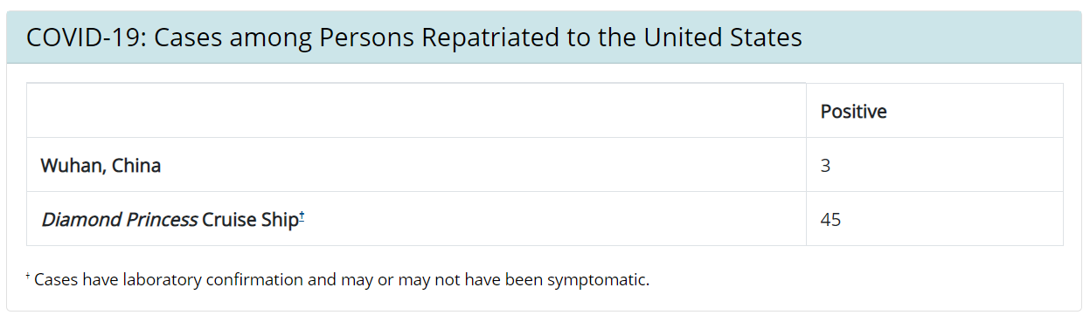
COVID-19: In the United States
Updated March 2, 2020
https://www.cdc.gov/coronavirus/2019-ncov/cases-in-us.html
† Cases have laboratory confirmation and may or may not have been symptomatic.
Notes:
Updated: 2/3/2020

Slide 10
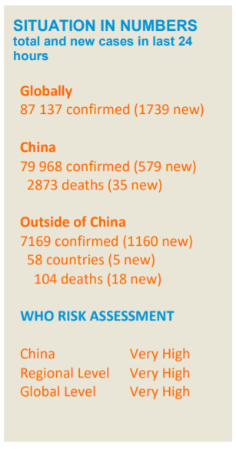
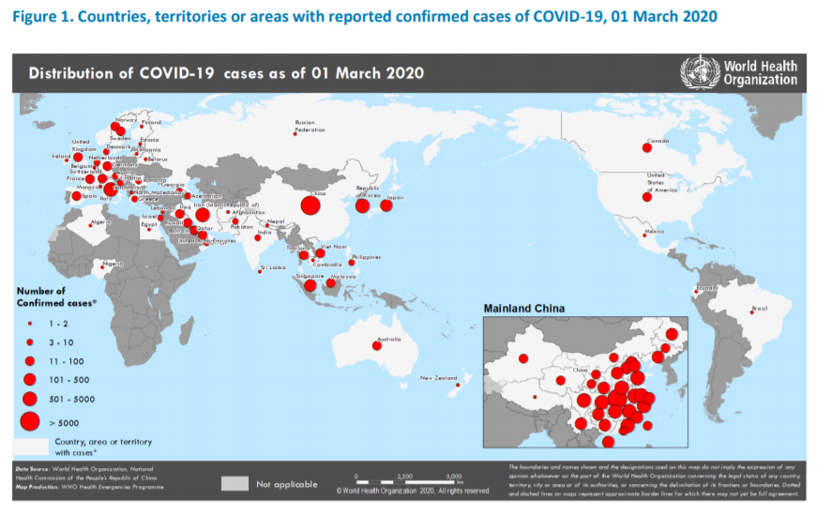
Confirmed COVID-19 Cases Globally
Confirmed COVID-19
Cases Globally
References: *World Health Organization (WHO) 2019-nCoV Situation Report 41
Updated March 2, 2020
Notes:
Updated: 2/3/2020
References: *World Health Organization (WHO) 2019-nCoV Situation Report – 13
**2019-nCoV Global Cases by John Hopkins CSSE

Slide 11
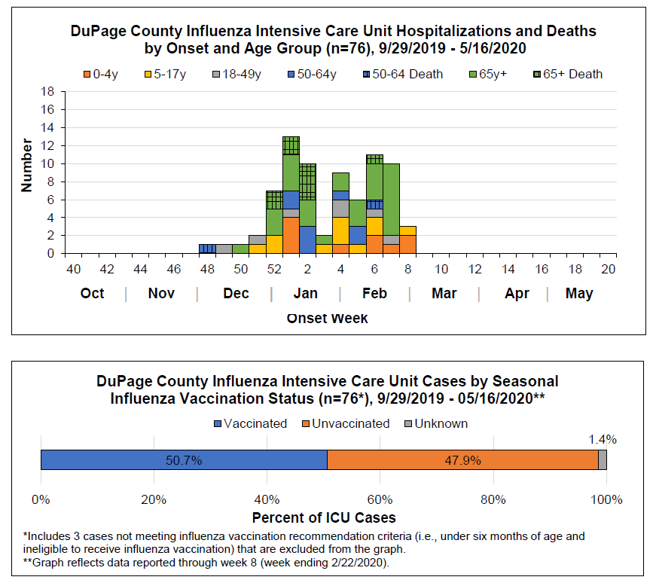
Seasonal Influenza Update
Seasonal Influenza
It is currently flu and respiratory disease season, and flu activity is still high and expected to continue for a number of weeks.
CDC recommends getting a flu vaccine, taking everyday preventive actions to stop the spread of germs, and taking flu antivirals if prescribed.
Source: 2020 DuPage County Flu Report: Week 8
https://www.dupagehealth.org/248/Surveillance-Reports-and-Resources

Slide 12
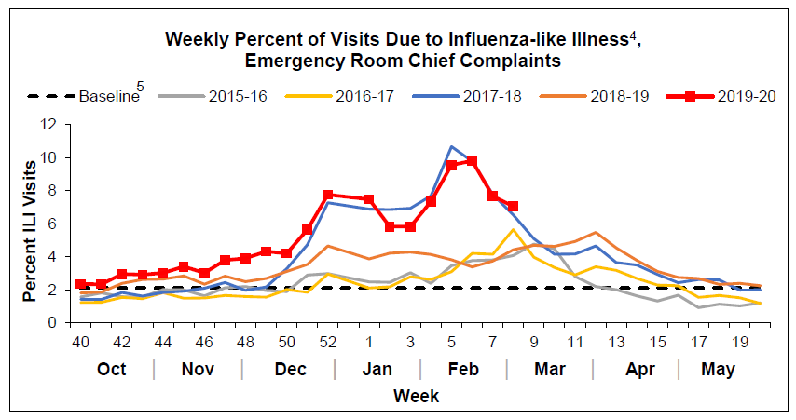
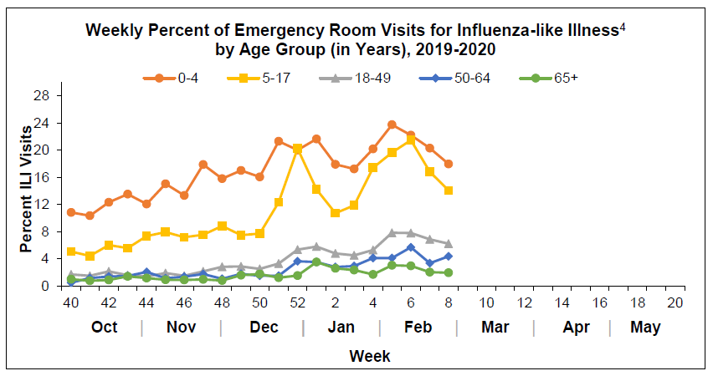
Seasonal Influenza Update
Source: 2020 DuPage County Flu Report: Week 8
https://www.dupagehealth.org/248/Surveillance-Reports-and-Resources

Slide 13

Public Health Response:
Containment and Mitigation
SCHOOLS
Phase 1:
Case identification, active monitoring
Phase 2
(+ Phase 1):
Broader community-wide education and
preparation
Phase 3
(+ Phases 1&2):
Implementation of some or all
non-pharmaceutical
intervention activities
Phase 4
(+ Phases 1-3):
Vaccine and treatment availability
(12-24 months)
Phase 5
On-going/routine disease, vaccination efforts
1
2
3
4
5
BE AWARE AND
PREPARE
MINIMIZE IMPACT
HEALTHY HABITS

Slide 14
COVID-19: Update
DuPage County Health Department Response
Active monitoring of contacts potentially exposed to COVID-19
Follow-up based on the type of contact they had
14 days following their last potential exposure
Checking daily to assess for the presence of fever and symptoms
Goal is to monitor the health of the person and to take actions if the person develops symptoms or is lost from follow-up
Coordinate safe and timely evaluation and care
Coordination with Illinois Department of Public Health (IDPH) & Centers for Disease Control and Prevention (CDC)
Coordination with local healthcare providers, Emergency Medical Services, hospitals, schools and businesses

Slide 15
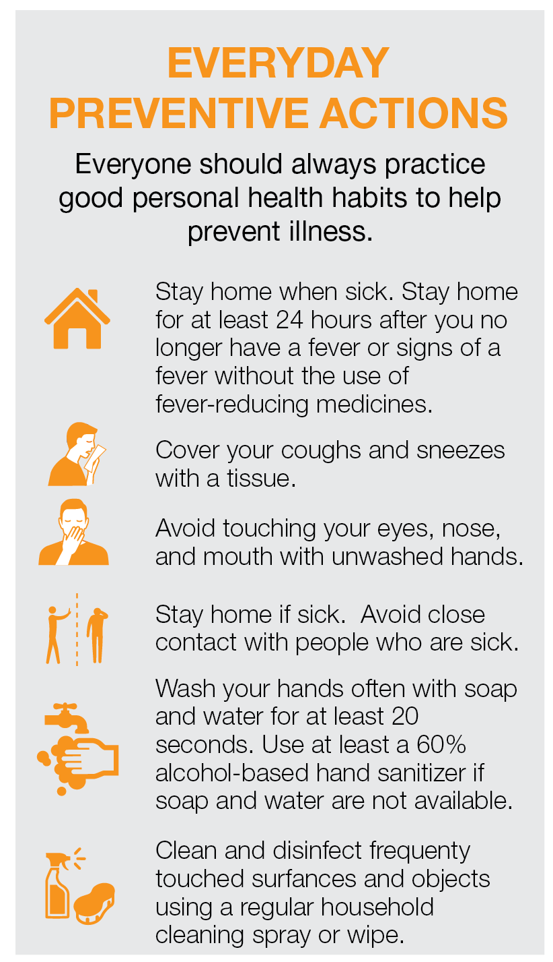
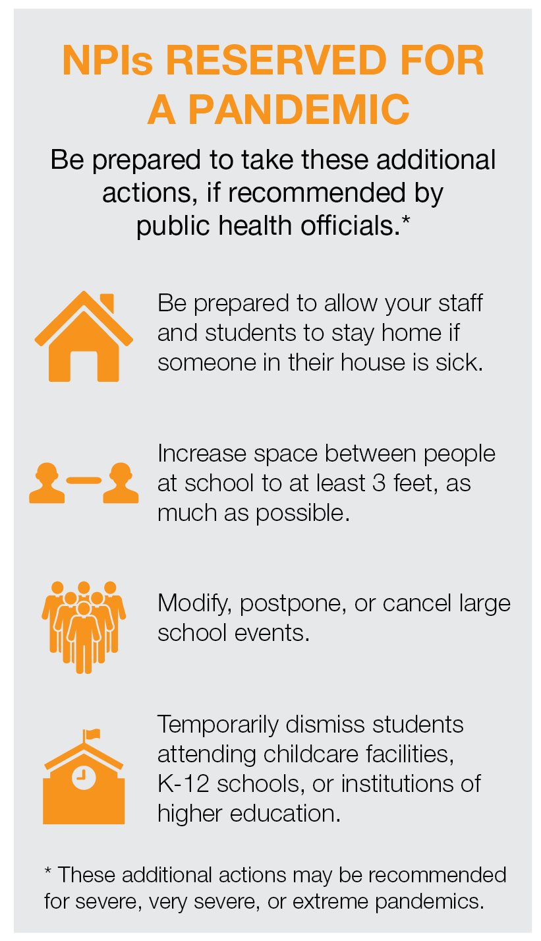
Prevention & Treatment
There is currently no vaccine or specific antiviral treatment for COVID-19.
Non-Pharmaceutical Interventions (NPIs) can help slow the spread.
These measures might be critical to avert widespread COVID-19 transmission.
Prepare Your
School Community
CDC has developed recommendations for preventing the spread of viruses in communities.
Studies have shown that early layered implementation of these interventions can reduce the community spread and impact of infectious pathogens.
Source: CDC - Get Your School Ready for Pandemic Flu August 2017
https://www.cdc.gov/coronavirus/2019-ncov/about/prevention-treatment.html

Slide 16
COVID-19: SCHOOL GUIDANCE
COVID-19: Update
Guidance for Illinois Students Regarding COVID-19
As of 2/28/20:
IDPH does NOT recommend:
  the use of masks or gloves
  cancelling mass gatherings
  cancelling classes
Are any special cleaning procedures needed?
At this time, no special sanitizing processes beyond routine cleaning are necessary or recommended to slow the spread of respiratory illness. Schools should follow standard processes for routine cleaning and disinfecting with an EPA-registered product. General infection control guidance is available at www.cdc.gov/infectioncontrol.
Source: IDPH Guidance Issued 2/5/2020
http://www.dph.illinois.gov/sites/default/files/publications/2019-nCoV%20Guidance%20for%20K-12%20Schools%2002.19.2020%20IDPH.pdf

Slide 17
Prepare Your School Community
Keep Schools Safe, Open and Operational.
Notes:
Updated: 2/02/2020

Slide 18
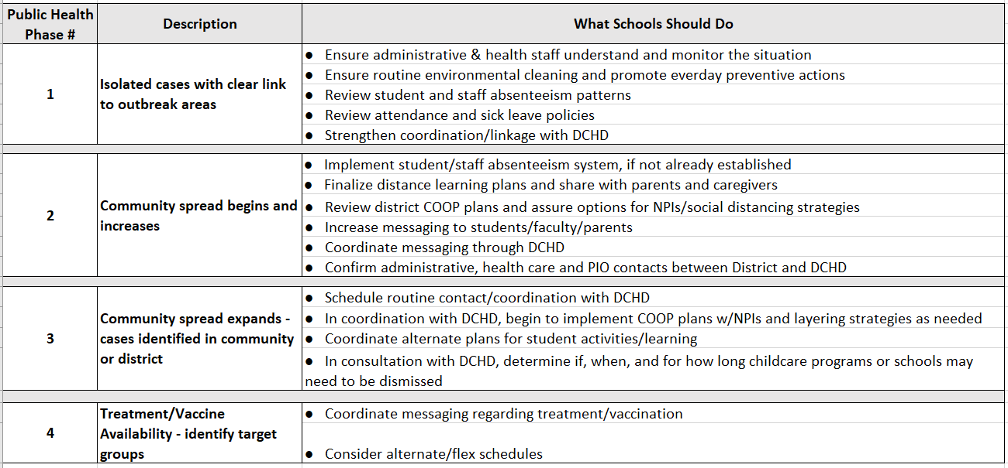
COVID-19: SCHOOL GUIDANCE
Public Health Guidance for Schools
* Refer to CDC’s Interim Guidance for Administrator’s of US Childcare Programs and K-12 Schools to Plan, Prepare, and Respond to Coronavirus Disease (COVID-19)

Slide 19
COVID-19: SCHOOL GUIDANCE
Public Health Contacts for Schools
Routine | Event
Primary Contact: Communicable Disease Epidemiology (630) 221-7553 After Hours (630) 682-7400 | Primary Contact: Karen Ayala, Executive Director DuPage County Health Department (630) 221-7401 After Hours (815) 762-9747
Secondary Contact: Bev Govednik – School Health Supervisor (630) 221-7300 bgovedni@dupagehealth.org | Secondary Contact: Chris Hoff, Community Health Resources Director DuPage County Health Department (630) 221-7571 After Hours (847) 409-1546

Slide 20
COVID-19: SCHOOL GUIDANCE
CDC Guidance for Schools
This interim guidance is based on what is currently known about the transmission and severity of coronavirus disease 2019 (COVID-19).
    To prepare for possible community transmission of COVID-19, the most
    important thing for schools to do now is plan and prepare. As the global
    outbreak evolves, schools should prepare for the possibility of community-level outbreaks. Schools want to be ready if COVID-19 does appear in their communities.
Accessed: 2/29/20
https://www.cdc.gov/coronavirus/2019-ncov/specific-groups/guidance-for-schools.html

Slide 21

CDC Guidance for Schools
Schools which DO NOT have COVID-19
identified in their community
Emergency Operations Plans (EOPs)
Communications Plans
and Information-Sharing
Absenteeism
Monitor and plan for absenteeism.
Participate in the Health Department’s School Absenteeism Reporting System.
Review, update, and implement emergency operations plans (EOPs).
Create communications plans for use with the school community and information-sharing systems
with partners.
Establish Procedures
Cleaning
Additional Strategies
Establish procedures for students and staff who are sick at school.
Perform routine environmental cleaning.
Review CDC’s guidance for businesses and employers.
https://www.cdc.gov/coronavirus/2019-ncov/specific-groups/guidance-business-response.html
Accessed: 2/29/20
https://www.cdc.gov/coronavirus/2019-ncov/specific-groups/guidance-for-schools.html
Accessed: 2/29/20

Slide 22
COVID-19: SCHOOL GUIDANCE
CDC Guidance for Schools
SCHOOLS WITH identified cases of COVID-19 in their community
In consultation with DCHD, determine if, when, and for how long childcare programs or schools may need to be dismissed.
    Temporarily dismissing childcare programs and K-12 schools is a strategy to stop or slow the further spread of COVID-19 in communities.
    During school dismissals, childcare programs and schools may stay open for staff members (unless ill) while students stay home.
    Keeping facilities open
      a) allows teachers to develop and deliver lessons and materials remotely, thus maintaining continuity of teaching and learning; and
      b) allows other staff members to continue to provide services and help with additional response efforts.
Accessed: 3/2/20
https://www.cdc.gov/coronavirus/2019-ncov/specific-groups/guidance-for-schools.html

Slide 23
CDC Guidance for Schools
SCHOOLS WITH identified cases of COVID-19 in their community
Step 1:
Talk with the Health Department
If an ill student or staff member attended school prior to being confirmed as a COVID-19 case:
Local health officials may recommend temporary school dismissals if a student or staff member attended school prior to being confirmed as a COVID-19 case.
Schools should work with the health department and other relevant leadership to communicate the possible COVID-19 exposure.
If a student or staff member has been identified with COVID-19, school and program administrators should seek guidance from the health department to determine when students and staff should return to schools and what additional steps are needed for the school community.
Childcare and school administrators should work in close collaboration and coordination with DCHD officials to make dismissal and large event cancellation decisions.
Schools are not expected to make decisions about dismissal or canceling events on their own.
Schools can seek specific guidance from local health officials to determine if, when, and for how long to take these steps.
Accessed: 2/29/20
https://www.cdc.gov/coronavirus/2019-ncov/specific-groups/guidance-for-schools.html

Slide 24
CDC Guidance for Schools
SCHOOLS WITH identified cases of COVID-19 in their community
If schools are dismissed, schools can consider the following steps:
Temporarily cancel extracurricular group activities and large events.
  Cancel or postpone events such as after-school assemblies and pep rallies, field trips, and sporting events.
Discourage students and staff from gathering or socializing anywhere.
  Discourage gatherings at places like a friend’s house, a favorite restaurant, or the local shopping mall.
Ensure continuity of education
Review continuity plans, including plans for the continuity of teaching and learning. Implement
e-learning plans, including digital and distance learning options as feasible and appropriate.
Ensure continuity of meal programs.
Consider ways to distribute food to students.
If there is community spread of COVID-19, design strategies to avoid distribution in settings where people might gather in a group or crowd. Consider options such as “grab-and-go” bagged lunches or meal delivery.
Consider alternatives for providing essential medical and social services for students.
Continue providing necessary services for children with special healthcare needs, or work with the state Title V Children and Youth with Special Health Care Needs (CYSHCN) Program.

Slide 25
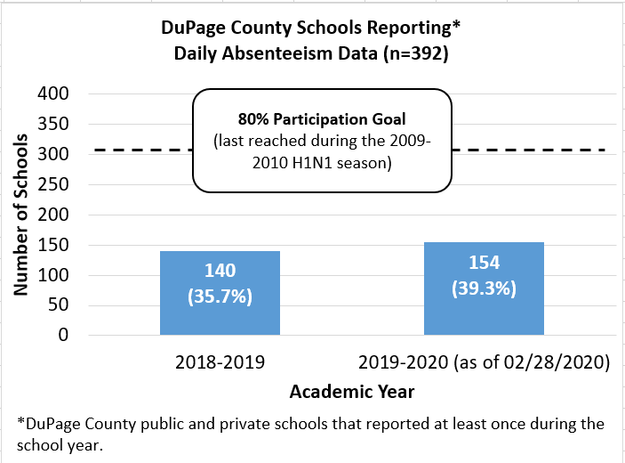
Data-Driven Action
Keep Schools Safe, Open and Operational.
Participate in the
DuPage County Health Department
Absenteeism Reporting System
Sign Up Today!
https://connect.dupagehealth.org

Slide 26
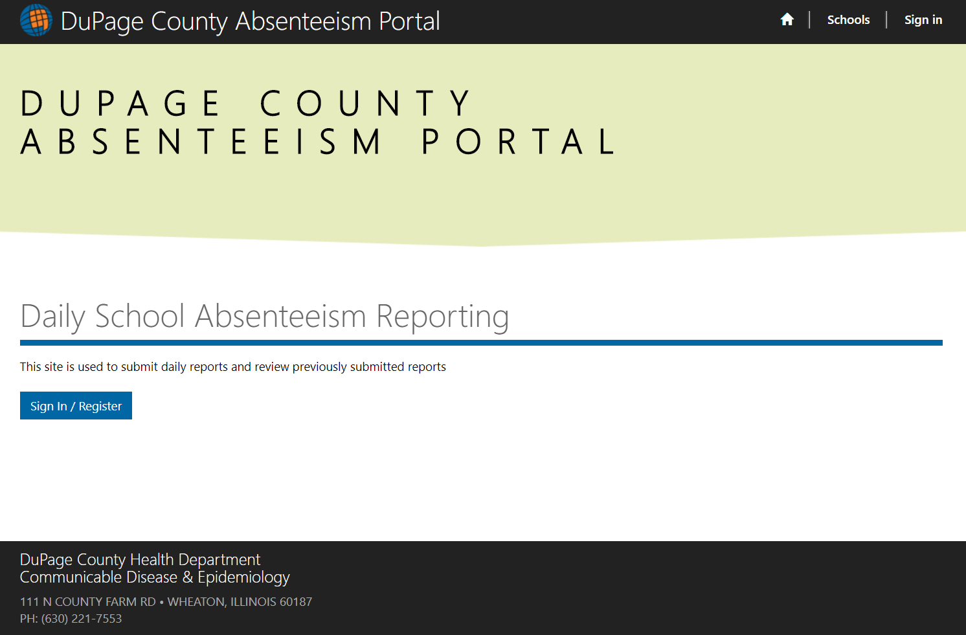
Informed Decision Making Tool
Provides data on total absenteeism, illness
Records influenza-like illness (ILI) symptoms: fever and cough and/or sore throat
On-line form for daily reporting
Daily alerts of rates that exceed a threshold
Results interpreted in conjunction with other surveillance data
Prepare Your
School Community
Keep Schools Safe, Open and Operational.
Participate in the DuPage County Health Department
Absenteeism Reporting System
Sign Up Today!
https://connect.dupagehealth.org

Slide 27
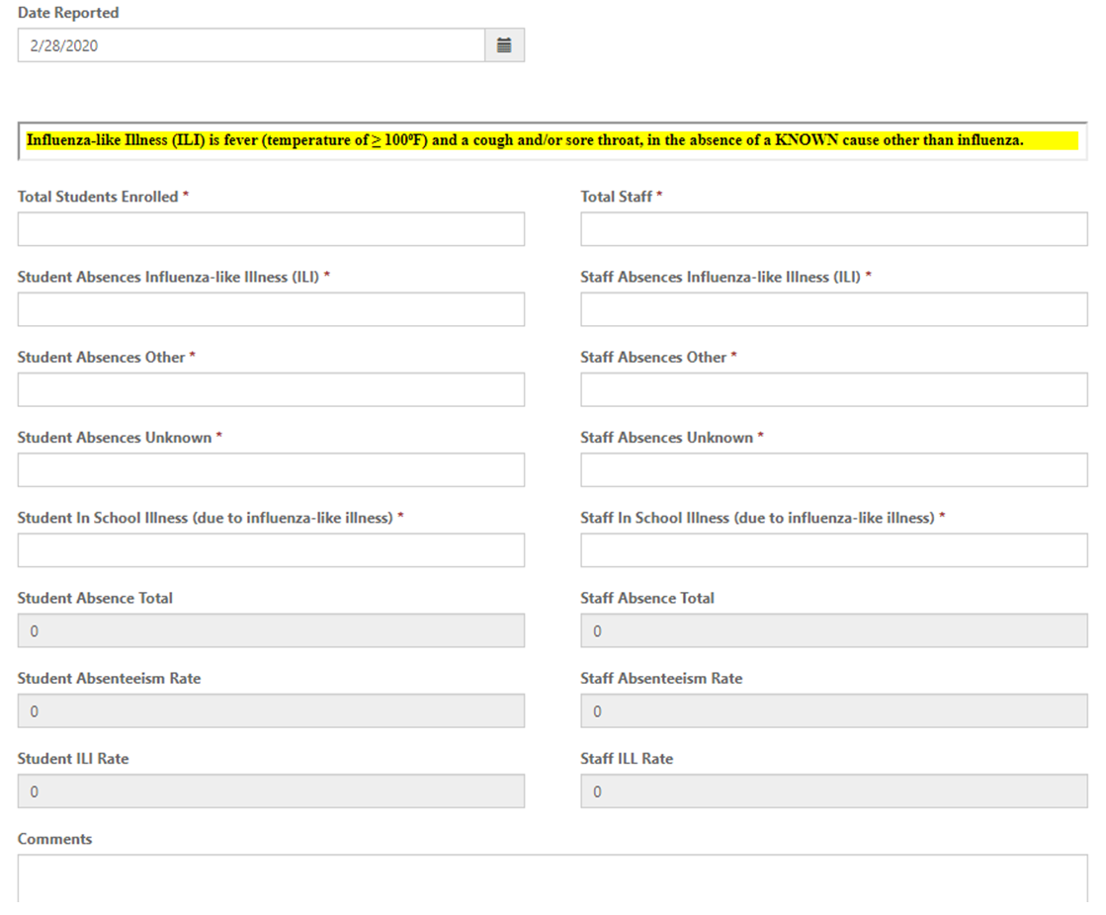
Easy to Use On-line Form for Daily Reporting
Prepare Your
School Community
Keep Schools Safe, Open and Operational.
Participate in the DuPage County Health Department
Absenteeism Reporting System
Sign Up Today!
https://connect.dupagehealth.org

Slide 28
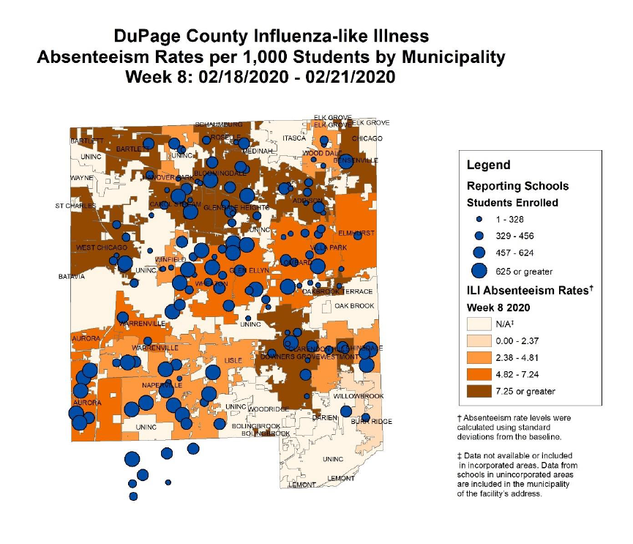
Prepare Your
School Community
Keep Schools Safe, Open and Operational.
Participate in the DuPage County Health Department
Absenteeism Reporting System
Sign Up Today!
https://connect.dupagehealth.org

Slide 29
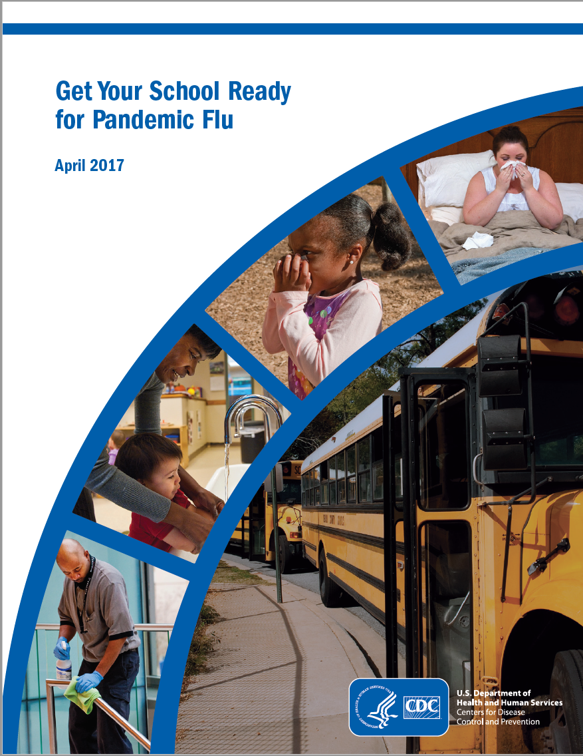
Emergency Operations Plans
CDC has developed this school-specific guidance document:
Get Your School Ready for Pandemic Flu – August 2017
We encourage all schools to assure that eky prevention strategies are included in your emergency operations plan and that you are promoting use of the following:
Promote the daily practice of everyday preventive actions at all times.
Provide respiratory illness prevention supplies in your school.
Plan for staff and student absences.
Develop a method for tracking respiratory illness-related staff and student absences.
Identify space that can be used to separate sick people (if possible).
Plan ways to increase the space between people to at least 3 feet or limit face-to-face contact between people at school.
Develop a risk-assessment and risk-management process for your school.
Review your process for planning school events.
Prepare Your
School Community
Keep Schools Safe, Open and Operational.
CDC has developed recommendations for preventing the spread of viruses in communities.
https://www.cdc.gov/nonpharmaceutical-interventions/pdf/gr-pan-flu-ed-set.pdf
The above items as well as consideration of/planning for school dismissals and emergency communication plans are covered in this CDC school guidance document.

Slide 30
COVID-19: School Guidance
Guidance for Illinois Students Regarding COVID-19
Due to recent acceleration of COVID-19 transmission worldwide and in accordance with current federal guidance, the Illinois Department of Public Health (IDPH) recommends the following:
Any student returning from mainland China, South Korea, Italy and Iran should not attend school for 14 days after the return date.
Absences for this purpose should be excused.
Family members of these students should not attend work if they also traveled to
mainland China, South Korea, Italy and Iran.
Source: IDPH Guidance Issued 3/2/2020
http://www.dph.illinois.gov/sites/default/files/COVID-19TravelNoticeAlertUpdate.2.28.2020.2.pdf

Slide 31


COVID-19: School Guidance
Preventing Stigma and Bullying
DuPage ROE Policy and Resources:
www.dupageroe.org/resources/
bullying-policy
Guiding Principles:
Protecting dignity and privacy; treating people with respect, fairness, and compassion
To prevent stigma and discrimination in schools, do not make determinations of risk based on race or country of origin

Slide 32

COVID-19: School Guidance
Preventing Stigma and Bullying
Please do not let fear or panic guide your actions.
For example, please do not assume that just because someone is of Asian descent that they have this new coronavirus. There are about 4 million Chinese-Americans in this country. We recognize the uncertainty of the current situation. As always, CDC public health experts drive to make the best recommendations on the most up-to-date data which will continue to inform our guidance.
    Dr. Nancy Messonnier, Director of CDC’s National Center for Immunization and Respiratory Diseases
    (CDC Telebriefing on January 31, 2020)

Slide 33


COVID-19: School Guidance
Messaging for Parents Regarding COVID-19
For questions regarding your child’s attendance, please contact the school. For additional questions and concerns, please contact the DuPage County Health Department so specific situations may be evaluated on a
case-by-case basis.
The DuPage County Health Department can be reached at
(630) 221-7553 (8 a.m. – 4:30 p.m.) or at (630) 682-7400 after hours.
Behavioral Health Support
  For anyone feeling emotional distress or in need of emotional support, the Health Department Behavioral Health Crisis Hotline (630) 627-1700 is available 24 hours a day, 7 days a week, 365 days a year.
Source: IDPH Guidance Issued 2/5/20 http://dph.illinois.gov/sites/default/files/2019-nCoV%20Guidance%20for%20Students%2002.05.2020%20IDPH.pdf

Slide 34

COVID-19: RESOURCES
Website:
www.dupagehealth.org/
590/Coronavirus-Information
Website:
Website:
www.dph.illinois.gov/topics-services/diseases-and-conditions/diseases-a-z-list/coronavirus
www.cdc.gov/coronavirus/2019-nCoV/index.html
DuPage County residents and healthcare professionals with concerns about exposure or specific symptoms are encouraged to call the DCHD Communicable Disease and Epidemiology (CDE) program at (630) 221-7553
(8:00 a.m. – 4:30 p.m.) or (630) 682-7400 after hours.
Illinois Novel Coronavirus
24/7 Hotline and Email Address
For questions about Coronavirus call or email:
1(800) 889-3931
DPH.SICK@ILLINOIS.GOV
24 hours a day, seven days a week.
Behavioral Health Crisis Hotline
(630) 627-1700 is available 24 hours a day, 7 days a week, 365 days a year.

Slide 35


COVID-19: School Guidance
Find us on:
@DuPageHealth
@DuPageHD

Slide 36
COVID-19: School Guidance
THANK YOU!
QUESTIONS?

